Slide 1
INFOLAND, HMLR Digital Day 070214
Trude B-J Margel, tbm@eiendomsinfo.no, mob: +47 958 30 978

Slide 2
Norsk Eiendomsinformasjon (NE):
Expertise in
registration systems
and digital data management
in the property market since 1987.

Slide 3


Main products / services
Local property information from municipal offices, information from building societies and mapping authority, basis for real estate agency systems, construction companies, architects etc.
Properties Registry (EDR)
Overview of all legal / financial and technical information recorded on properties in the Land Register and Cadastre.
Document Flow for e-Conveyancing
Proxy
Processing
Signature
Valuation
Identification
Archive

Slide 4
Infoland «all-in-one» portal for property information combines all information decreed mandatory by law in order to handle a property transaction

Slide 5

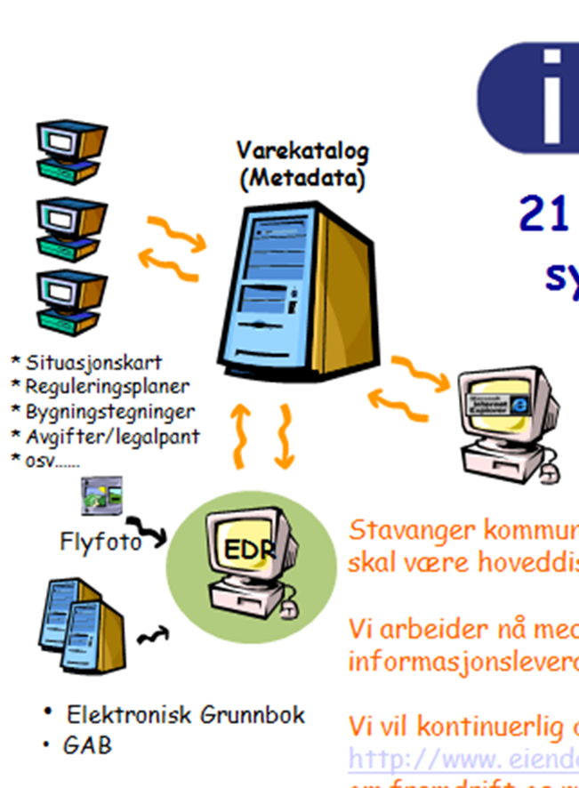
Background
Infoland was launched as a tailored solution for the municipality of Stavanger, June 1999.
The municipality of Stavanger announced that Infoland was to be their main distribution channel for property information.
Other relevant data suppliers were invited to use Infoland as their distribution channel.
Soon, other municipalities joined in and today, Infoland covers almost 90 % of Norway’s properties and is Norway’s only all-in-one portal for land information.

Slide 6
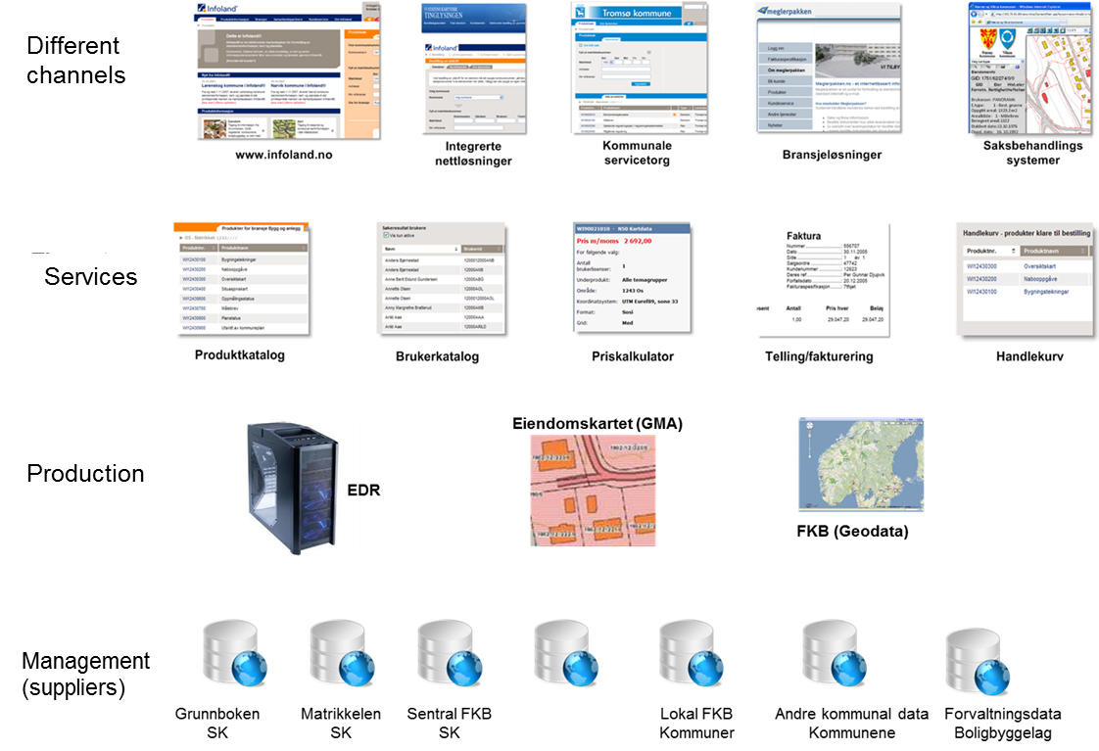

The basic structure

Slide 7


The business model – a symbiotic relationship
The supplier defines the price of each service they make available to Infoland (the purchase price).
The supplier receives the revenue from their sold items through the portal minus SLA costs, support, customer service, etc.
Once a month an overview of sold items is sent to every supplier who in turn sends an invoice to the Infoland.
Infoland takes the risk of non-payment.
Every product has a defined delivery time. If the delivery time is exceeded, the price is reduced (at the expense of the supplier).
This ensures quality, delivery time and a reciprocal desire to provide optimal service to the market.

Slide 8

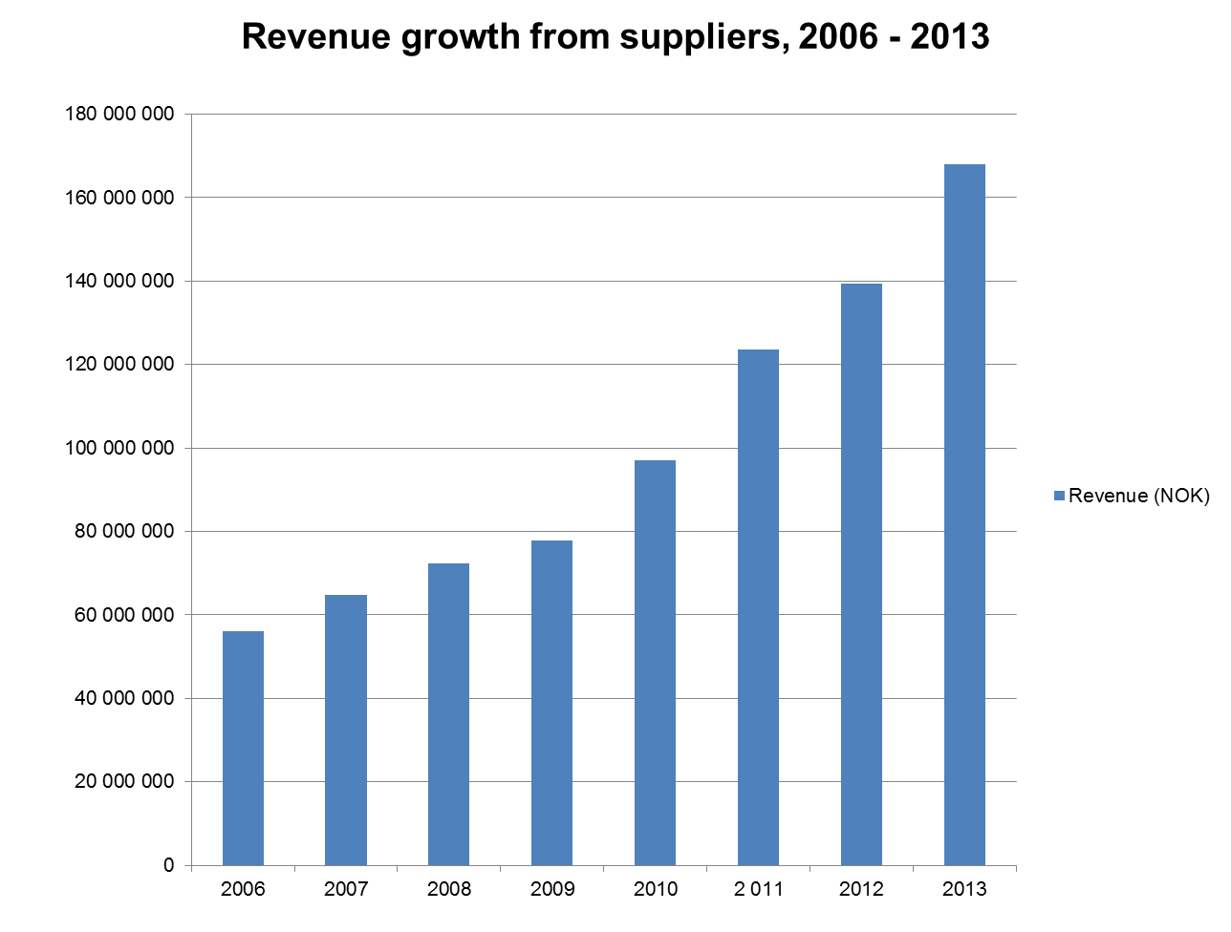
Infoland revenues
The revenue from the suppliers to Infoland represented a turnover of NOK 139,4 mill. (GBP 14 mill) in 2012.
In 2013, the Infoland portal commands a forecasted turnover of over NOK 168 mill (GBP 16,9 mill).
Since 2006, the suppliers have received revenues of over NOK 610 mill through Infoland.

Slide 9

A sustainable source of information for the stakeholders
Infoland as of November 2013:
Total number of suppliers: 343
271 municipalities (representing almost 90 % of Norway’s properties).
Other suppliers 72, including housing cooperatives, utilities, mapping data and others.
5419 company subscription
36 500 users from all categories
Over 369.000 transactions were provided through Infoland in the last 12 months.

Slide 10
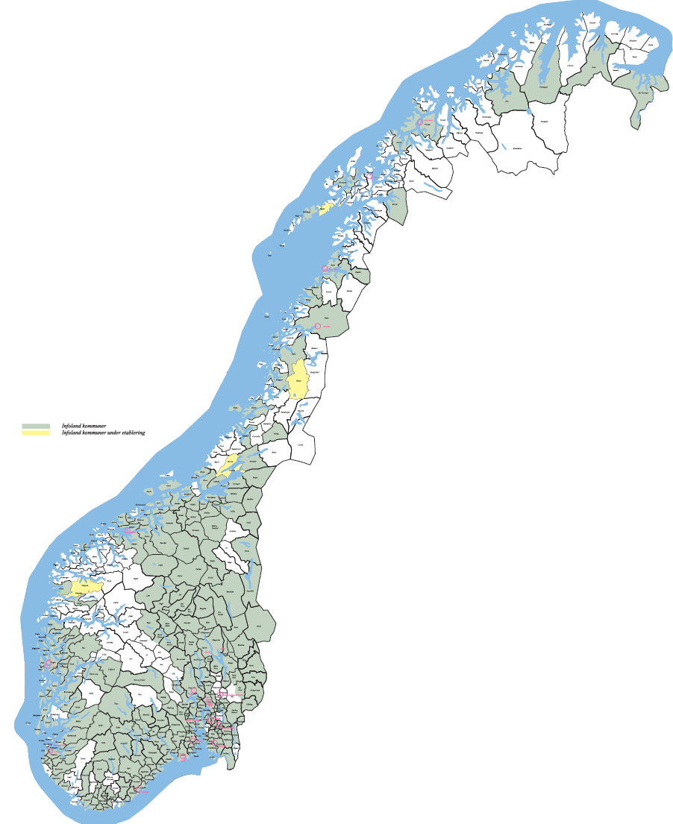
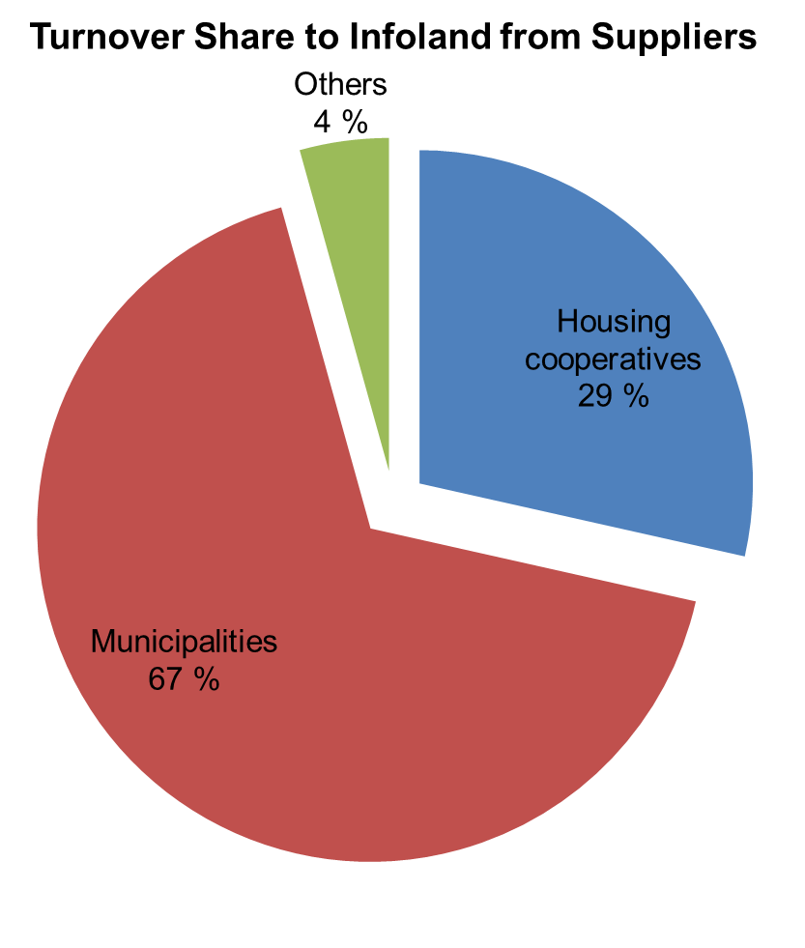
The municipalities are on board
67 % of the the turnover to Infoland
comes from the Local Authorities.

Slide 11
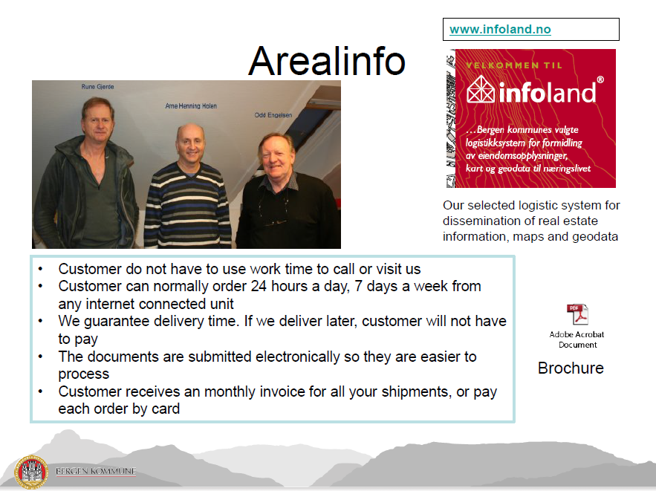
Municipality of Bergen: “Welcome to Infoland! Our selected logistic system for dissemination of property information, maps and geodata.”
The municipalities are on board
The municipalities embrace Infoland as their own.
By recommending infoland.no, they are offering improved 24 hour service.
The municipalities can guarantee delivery time or no cost to the user.
Easy processes, easy payment options.
The municipalities free up personell to focus on other work areas.
Bergen Municipality

Slide 12

The Municipality of Bergen: “Infoland means income for the municipalities”
No billing costs.
No payment tracking.
No system costs.
Internal efficiency gains.
No record keeping / archiving.
Fewer phone calls.
Reduced desk top work.
More time for public service.
Bergen Municipality

Slide 13
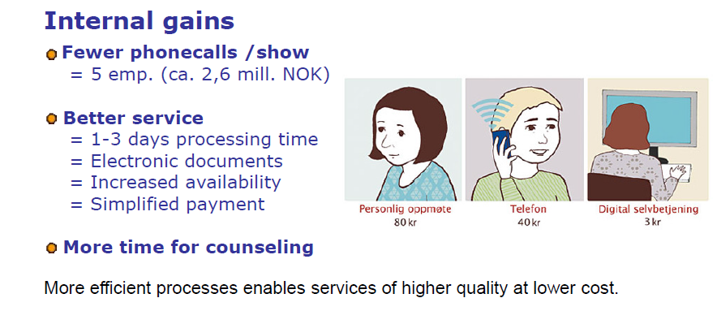
What is achieved through Infoland for the Municipalities?
Personal appearance
Telephone time
Digital self service
Bergen Municipality

Slide 14
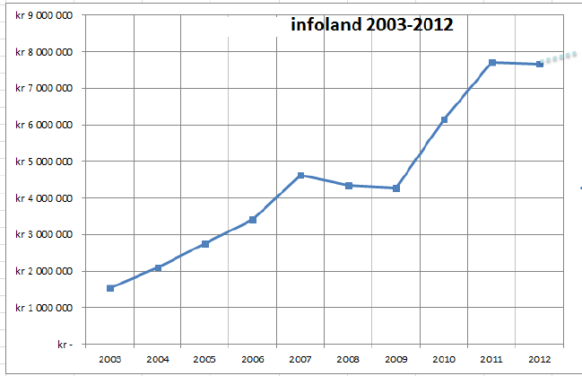
Bergen Municipality: Revenue growth 2003-2012 (NOK)
Bergen Municipality

Slide 15
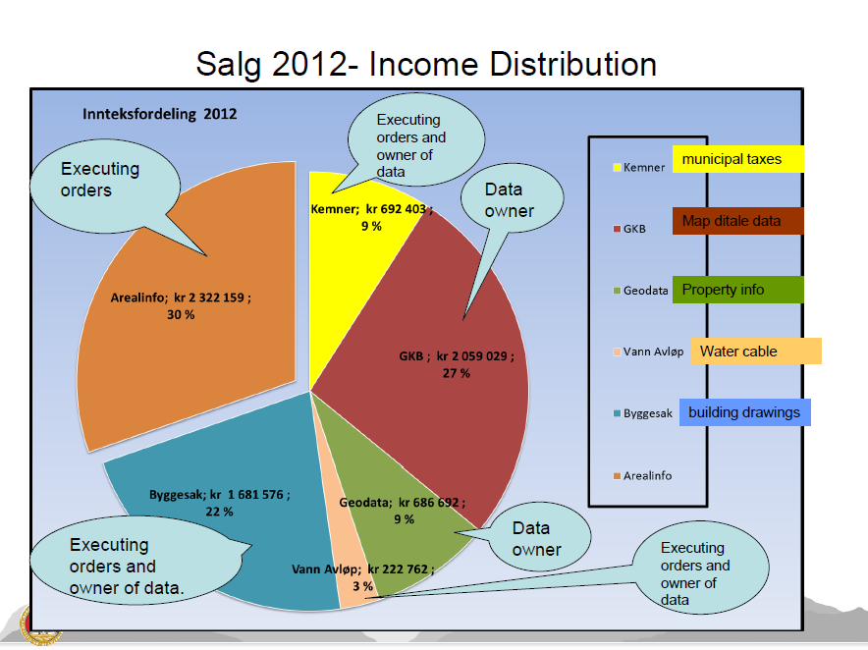
Free disposition of funds, motivates a symbiotic relationship
The Municipality of Bergen spreads its income from Infoland into other areas of growth and development, fulfilling their visions of providing optimal public service.
A freedom from dependence on
government budget allocations alone.
Bergen Municipality

Slide 16
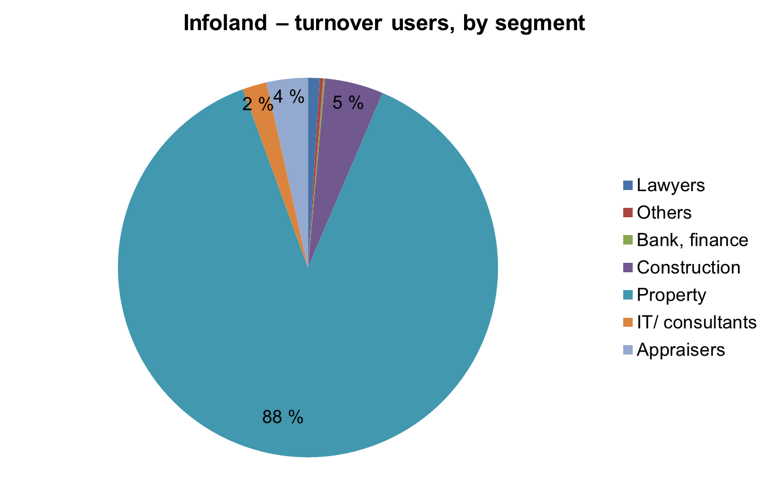
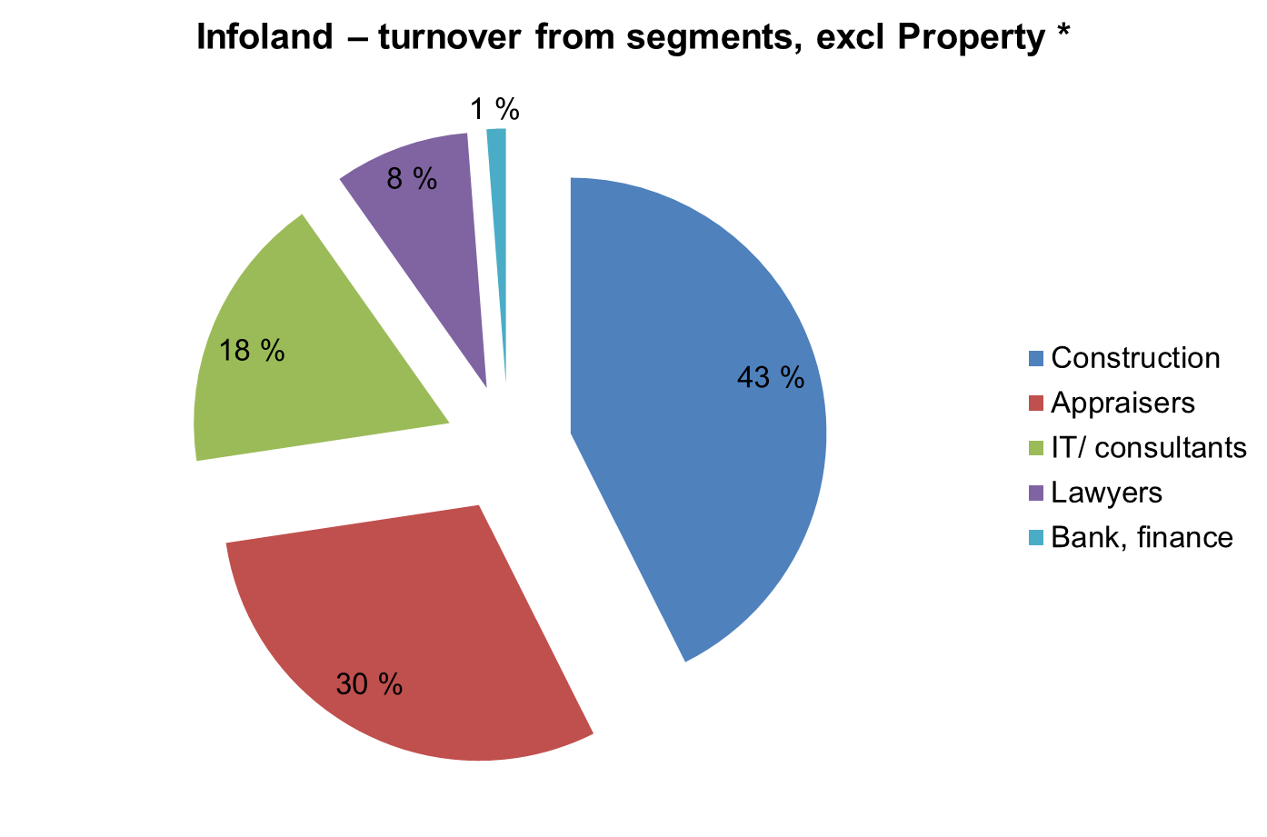
Users of Infoland
88 % of the income from users of Infoland are from the Real Estate segment.
The role of the real estate broker in Norway is similar to that of the solicitor in the UK. The Norwegian estate agents are required by law to be certified in property law and business.
The next largest segments are Construction (Building Development, Architects and Contracting) and Appraisers.
These user groups together represent over 369 000 transactions in the last 12 months.
* Property is The Real Estate segment, similar to the role of Solicitors in the UK.

Slide 17
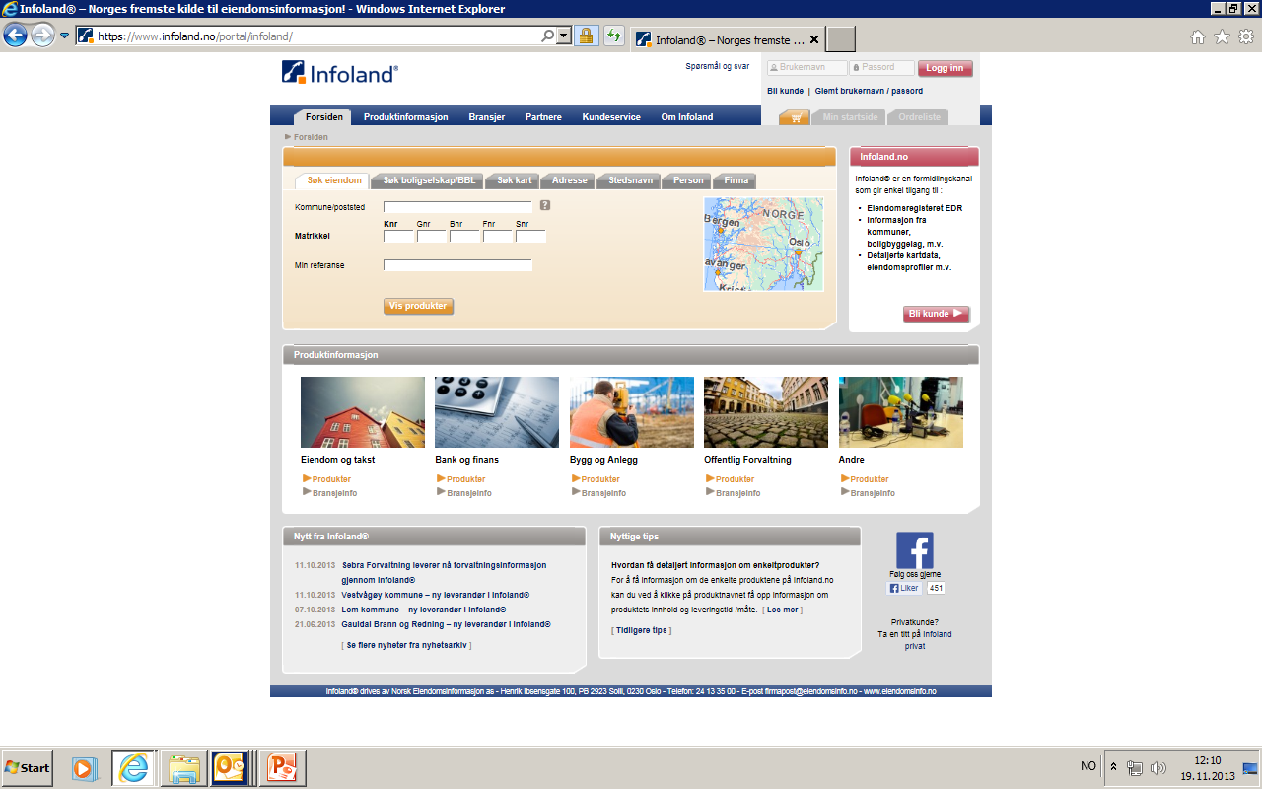
A demonstration

